Slide 1
Team Based Learning Week7

Slide 2
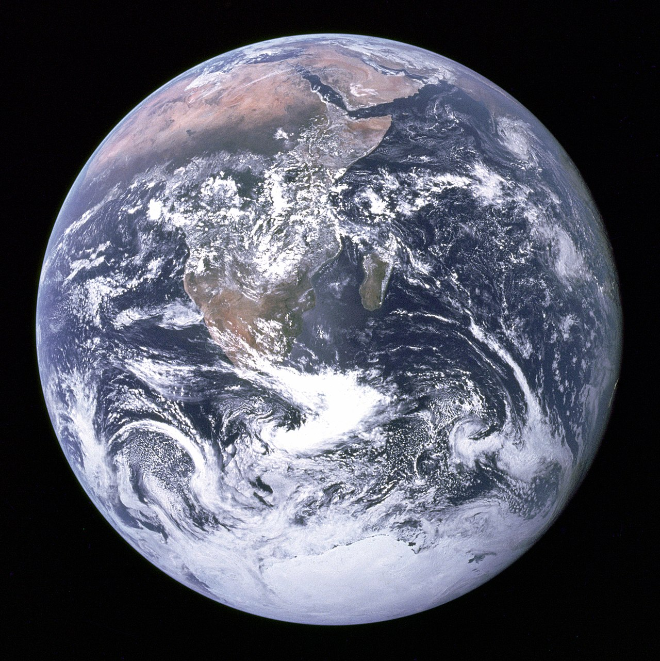
The Gaia hypothesis has been criticized because natural selection (survival of the fittest) would not be possible if Gaia (the whole biosphere) is considered a single organism
This reveals that Gaia does not need to evolve.
Natural selection can occur through differential persistence, thus a single entity such as Gaia can evolve, even in the absence of procreation.
This shows that the Gaia hypothesis is incompatible with evolution.

Slide 3
Which of the following is a monophyletc group sensu Hennig (or holophyletic sensu Mayr)?
Reptiles
Fish
Eukaryotes
Protists
Green algae
Note: Willi Henning’s cladistics is at odds with Ernst Mayr’s understanding of taxonomic groups.
Notes:
Eukaryotes

Slide 4
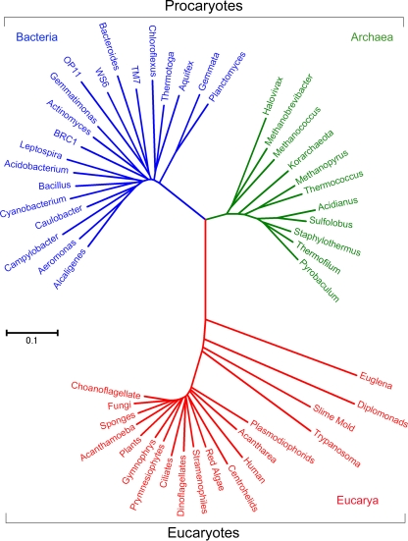
Rooting the tree of life
This is a repeat from an earlier TBL exercise that sadly some of you forgot.
The tree on the right is from W B Whitman’s review “The modern concept of the procaryote” 10.1128/JB.00962-08
Based on ancient duplicated genes, where would this tree be rooted?
position 1 (on the bacterial branch)
position 2 (under the central trifurcation)
position 3 (on the eukaryotic branch)
position 4 (on the archaeal branch)
All of these are possible locations.
1
2
4
3
Notes:
position 1 (on the bacterial branch)

Slide 5
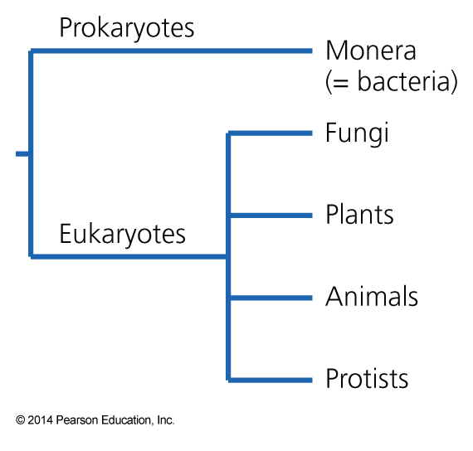
What is wrong or outdated with the 5-kingdom tree depicted below?
The deepest split is not between Pro- Eukaryotes, but between bacteria and the other cellular organisms
Protists and Prokaryotes are paraphyletic groups
Animals and Fungi should be depicted as sister groups
Plants and fungi should be depicted as sister groups
A, B, C are correct
Notes:
A, B, C are correct

Slide 6
What do we learn from the way Ernst Haeckel vertically arranged human populations in his stem-trees?
A) The vertical arrangement of the different groups was based on objective measures and did not reflect his prejudices and familiarity with the different groups.
B) Haeckel was a scientist and not a racist.
C) Haeckel did not have any prejudices about which populations were more advanced.
D) His stem-trees are one of many examples of how trees can be used to transport value judgments (primitive versus advanced) about groups, be they species or human populations.
Notes:
D

Slide 7
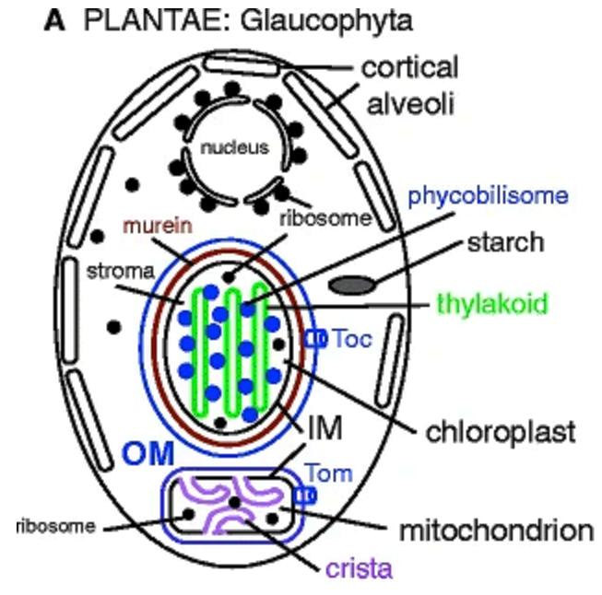
Glaucophytes (aka Glaucocystophytes) are a group of algae whose plastids are surrounded by two membranes. Between the two membranes is a murein sacculus (the bacterial cell wall consists of murein).
This indicates
that these algae resemble an early stage of the symbiosis between cyanobacteria and the eukaryotic host cell.
that these algae were the ancestors of red and green algae
that the Glaucophyte plastid is a primary plastid (evolved from the symbiosis between a eukaryote and a photosynthetic bacterium
that the Glaucophyte plastid is a secondary plastid (evolved from the symbiosis between a eukaryote and a photosynthetic eukaryote
A and C are correct
From: https://commons.wikimedia.org/wiki/File:709_2017_1147_Fig3a.jpg#/media/File:709_2017_1147_Fig3a.jpg modified from
https://link.springer.com/article/10.1007/s00709-017-1147-3

Slide 8
In the tree on the right, photosynthetic eukaryotes (algae and plants) are indicated with red and blue labels.
If this phylogeny reflects the evolutionary history of the nucleus, this indicates
that the algae form a monophyletic group.
that the eukaryotes with primary plastids form a paraphyletic groups.
that diatoms, kelp, chrysophytes, and xanthophytes likely form a monophyletic group
This can not be answered without knowing where the root is.
Relationships between some eukaryotic groups from https://www.ncbi.nlm.nih.gov/pmc/articles/PMC3147421/ .

